Slide 1
Part – I : Analog Electronics
Chapter-3:
Operational Amplifier and Applications
Reference:
Robert L. Boylestad, Louis Nashelsky, Electronic Devices & Circuit Theory, 11th Edition, PHI, 2012
Linear IC’s and Its applications By Roy Choudhary

Slide 2
MODULE 1: INTRODUCTION TO OPERATIONAL AMPLIFIER
Objectives:
At the end of this chapter, students will be able to:
Draw internal diagram of an OPAMP and briefly describe the functions.
List and define key parameters of an OPAMP.
Discuss OPAMP based amplifier topologies.
Design OPAMP based circuits for simple mathematical operations.

Slide 3
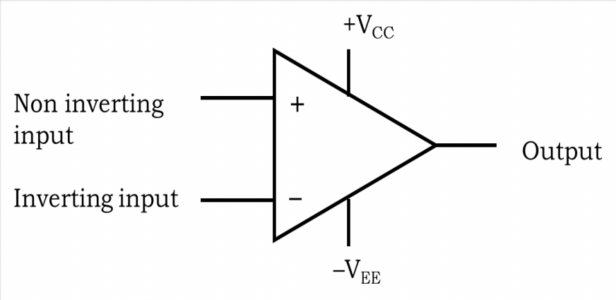
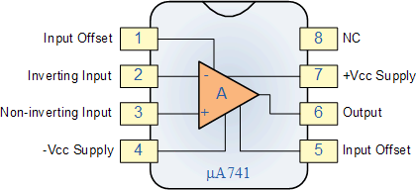
An op-amp is a very high gain direct coupled amplifier which can amplify signals over a wide range of frequencies.
.
Figure: Symbol of an op-amp.
Figure: Pin diagram of a typical µA741 op-amp
Notes:
●● The most commonly used op.amp. IC is μA741
● Op.amp. has two inputs and one output.
● The input marked “+” is known as Non-inverting input.
● The input marked “-“ is known as Inverting input

Slide 4
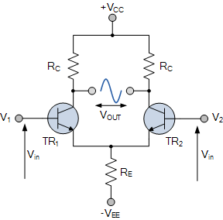
Differential amplifier
Ref: Differential Amp.docx

Slide 5
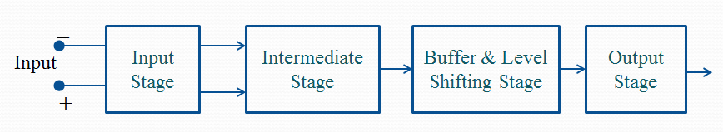
BLOCK DIAGRAM OF AN OPAMP
Notes:
● The function of the input stage is to amplify the difference between the two input signals.
Circuits are fabricated on a single silicon wafer resulting in very compact Integrated Circuits (ICs). Integrated Circuits can be broadly classified into two types: linear ICs and digital ICs. Digital ICs generally respond to two types of signals, logic low and ‘logic high’.
Linear ICs respond to linear or analog or time-varying signals. An operational amplifier (op-amp), timer, phase-locked loop (PLL) are some examples of linear
Input stage is a dual input, balanced output differential amplifier.
● Intermediate stage is a dual input, and unbalanced (single ended) output differential amplifier.
Input stage:
It consists of a dual input, balanced output differential amplifier.
It provides high differential gain, high input impedance and low output impedance.
Intermediate stage:
The overall gain requirement of an Op-Amp is very high. Intermediate stage is used to provide the required additional voltage gain.

Slide 6

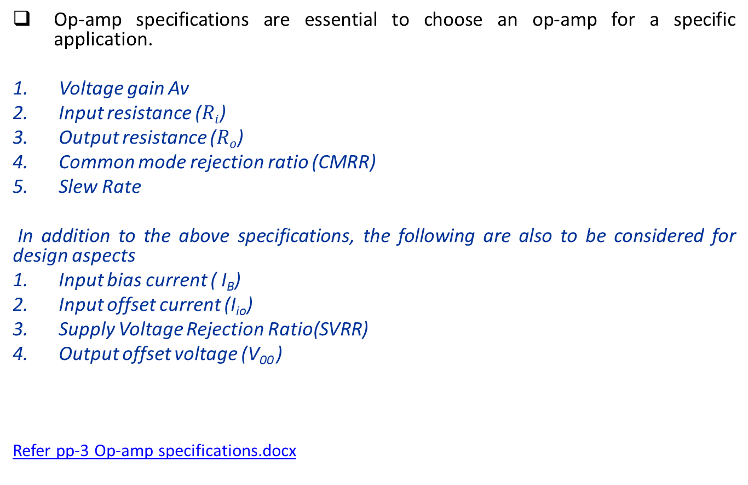
OPAMP SPECIFICATIONS & THEIR DEFINITIONS
Op-amp specifications are essential to choose an op-amp for a specific application.
Voltage gain Av
Input resistance ($Ri$)
Output resistance ($Ro$)
Common mode rejection ratio (CMRR)
Slew Rate
In addition to the above specifications, the following are also to be considered for design aspects
Input bias current ( I_{B})
Input offset current (I_{io})
Supply Voltage Rejection Ratio(SVRR)
Output offset voltage (V₀₀ )
Refer pp-3 Op-amp specifications.docx
Department of Electronics and Communication Engineering, MIT, Manipal

Slide 7
Ideal and Practical op-amp characteristic values
Sl. No. | Characteristics | Ideal | Practical
1 | Open loop voltage gain, A_{vo} | ∞ | 2*10⁵
2 | Unity gain BW | ∞ | 1MHz
3 | Input resistance, R_{i} | ∞ | 2MΩ
4 | Output resistance. R_{o} | zero | 75Ω
5 | CMRR | ∞ | 90dB
6 | Slew rate | high | 0.5 V/μs
7 | SVRR | zero | 150µV/V
8 | Input offset voltage | 0 | 6mv (max)
9 | Input offset current | 0 | 200 nA (max)
10 | Differential mode output voltage gain A_{d} | ∞ | 50000
11 | Common mode output voltage gain A_{c} | 0 | 10

Slide 8
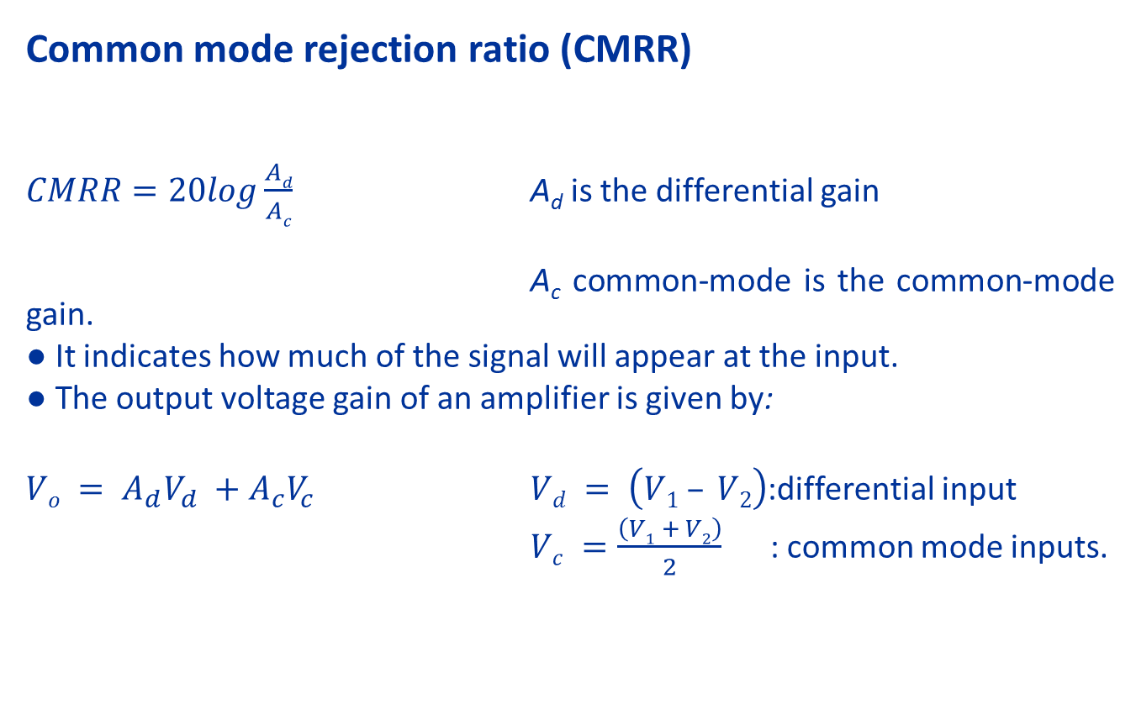
Common mode rejection ratio (CMRR)
$CMRR=20log\frac{Ad}{Ac}$ A_{d} is the differential gain
A_{c} common-mode is the common-mode gain.
● It indicates how much of the signal will appear at the input.
● The output voltage gain of an amplifier is given by:
$Vo = A_{d}V_{d} +A_{c}V_{c}$ $Vd = \left(V1 – V2\right)$:differential input
$Vc =\frac{\left(V1 + V2\right)}{2}$ : common mode inputs.
Department of Electronics and Communication Engineering, MIT, Manipal
Notes:
CMRR is a measure of tendency of the device to reject input signals common to both input leads.

Slide 9
EXERCISE
An OPAMP has differential voltage gain of 100,000 and CMRR of 60 dB. If non inverting input voltage is 150 μV and inverting input voltage is 140 μV, calculate the output voltage of OPAMP
Ans: 1.01 V
2. For an OPAMP, when v1 is 0.5 mV and v2 is –0.5 mV, output
voltage is 8 V. For the same OPAMP, when v1 = v2 = 1 mV,
output voltage is 12 mV. Calculate the CMRR of the OPAMP
Ans: 56.48 dB
Notes:
SolutionGiven A_{d}=100000, CMRR=60dB V₁= 150 μV, V₂= 140 μV
We know that $CMRR=20log\frac{Ad}{Ac}$
Therefore $\text{Ac}\text{ = }\text{Ad}\text{/(}{10}^{\frac{CMRR}{20}})=100$
Therefore $Vo = A_{d}V_{d} +A_{c}V_{c}$
$$Vd = \left(V1 – V2\right)=\text{10}\text{μ}\text{V} Vc =\frac{\left(V1 + V2\right)}{2}=145μV$$
$V_{o}=100000×\text{10}\text{μ}+100×145μV=1.0145V$

Slide 10
SELF TEST
A linear integrated circuit responds to
a) Analog signal b) Digital signal
c) Neither (a) nor (b) d) Both (a) and (b)
2. An op-amp can amplify
a) only ac signals b) only dc signal
c) Neither (a) nor (b) d) Both (a) and (b)
3. The ability of an op-amp to reject the common mode signal is termed as its
a) common mode gain b) differential mode gain
c) offset voltage d) CMRR
4. The CMRR is usually expressed in
a) volts b) decibels (dB)
c) volts/sec d) volts/mS
5. The potential at the virtual node w.r.t ground is
a) 0V b) 5V c) 10V d) none of them

Slide 11
Summary
In this module we have learnt:
Functions of each block of an op-amp.
Definitions & typical values of op-amp parameters.
Basic op-amp amplifiers & their output expression.

